Slide 1
Mobile ministry consultation
Executive Summary
April 17-18, 2015
Prepared by: Meredith Bird Visual Story Network

Slide 2
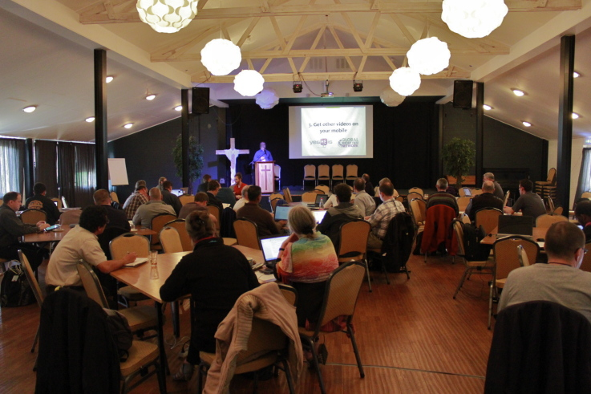
Overview
The 2015 Mobile Ministry Consultation was located at the De Betteld Retreat Center in Zelhelm, Holland.
95 mission strategists representing 56 organizations from 29 countries participated in the Mobile Ministry Consultation sponsored by the Mobile Ministry Forum (MMF).
This was the fifth MMF consultation and the first one held outside the United States. Presentations and discussions addressed a wide variety of issues critical to the use of mobile devices in ministry.
The consultation was hosted in conjunction with the Eurasia Media and Distribution Consultation. For more information, email info@emdcon.org.

Slide 3
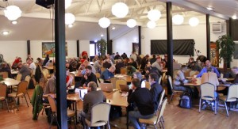
The Mobile Ministry Forum: Who We Are
The Mobile Ministry Forum (MMF) is a coalition of ministries working towards the goal of giving every unreached person a chance to encounter Christ and His kingdom in a compelling, contextualized fashion through their personal mobile device by 2020.

Slide 4
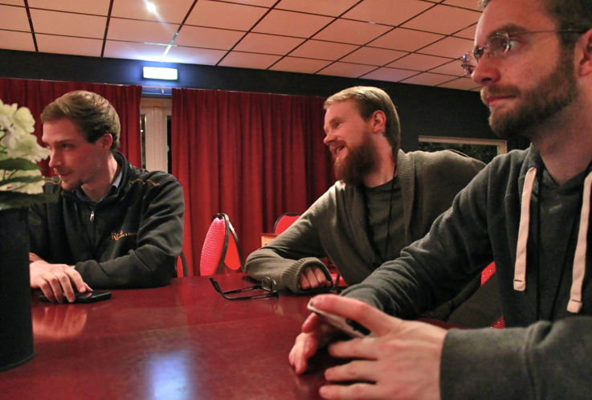
Opportunity
Mobile is the first personal mass medium.
Tomi Ahonen shared this at the 2015 Mobile Ministry Consultation. Forbes ranked Tomi as #1 in their list of global “mobile influencers.”
Mobile device technology is changing lives, families, cultures, and nations around the world at a rate that no other technology has in human history.
The mobile device presents a unique, two-way communication channel that represents the most important technology available for kingdom advancement.
But seek first his kingdom and his righteousness, and all these things will be given to you as well. Matthew 6:33 (NIV)

Slide 5
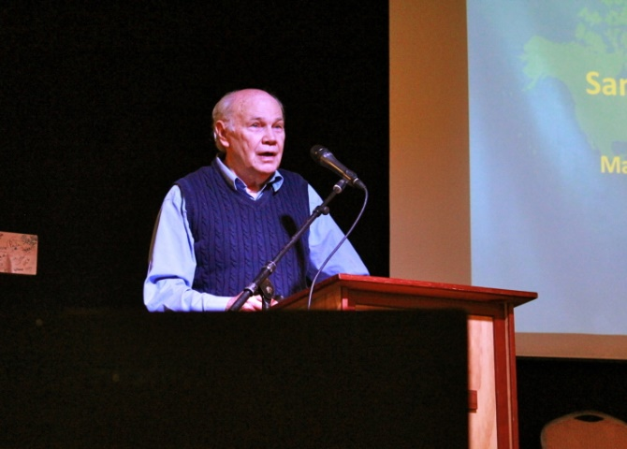
Presentations: Keynotes
State of Mobile Ministry:
Keith Williams
View the slidedeck here.
Mobile in Church Planting
Dr. Wayne Dye
View the slidedeck here.
View the recorded presentation here.
Mobilizing Your Existing Content
Sam Peckham
View the slidedeck here.
View the recorded presentation here.

Slide 6
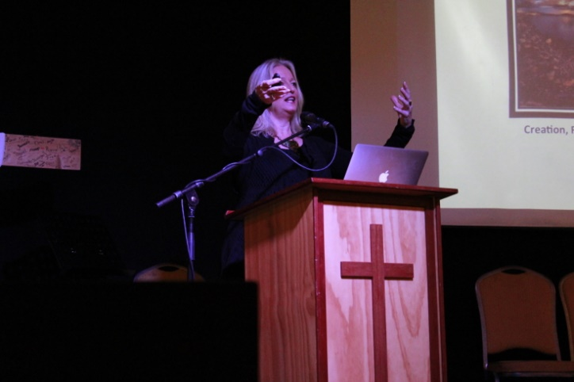
Presentations: Keynotes
Creating Culturally Relevant Content for the Mobile Device
Carol & Calvin Conkey
View the slidedeck here.
Principles of Online Mobile Platforms
Marc van der Woude
View the slidedeck here.
Five Years of Offline Ministry
Jill McKinnon
View the slidedeck here.
View the recorded presentation here.

Slide 7
Presentations: Keynotes
Future of Mobile
Tomi Ahonen
View the slidedeck here.
Building Relationships
Frank Preston
At this time, there are no resources available for this presentation.
Building Community
Ed
View the slidedeck here.

Slide 8
Presentations: Workshops
Getting Started Using Your Mobile in Missional Ways
Brian James
View the slidedeck here.
Exploring the Mobile World Where You Live
Keith Williams
View the slidedeck here.
Mobilize Your Existing Content
Darcie Drymon, Jay Clark
View Darcie’s slidedeck here.
View Jay’s slidedeck here.

Slide 9
Presentations: Workshops
Create New Content for the Mobile
Brian James, Keith Williams
View the slidedeck here.
Multi-Language Mobile Bible Distribution
Nancy Keel, Marguerite Inscoe
View the slidedeck here.
Building Your Own Bible Box
Jay Clark
View the slidedeck here.
Building Individual Relationships Through Social Media
Dr. Ty Grisham
At this time, there are no resources available for this presentation.

Slide 10
The Speakers: Up Close and Personal
Keith Williams
Keith is a member of the MMF Steering Team and serves as Director of Mobile Advance (www.mobileadvance.org), an initiative of WEC International. In his role Keith has assisted in the implementation of mobile ministry initiatives in approximately 30 countries and has helped in the development, testing and promotion of new mobile ministry approaches. Keith served as a field worker and team leader in the Arab world for a decade prior to launching Mobile Advance.
Carol and Calvin Conkey
Calvin and Carol are the Founders and International Coordinators of Create International, a global ministry of Youth With A Mission (YWAM) focused on producing effective media resources for unreached people groups. Since 1979 they have served as full-time media missionaries, producing hundreds of audio-visual resources and ministering in over fifty nations. They serve on several YWAM leadership teams, including the University of the Nations College of Communication, International Frontier Missions, and Contextual Resources, as well as co-ordinate the Global Media Network with the Call2All campaigns.

Slide 11
The Speakers: Up Close and Personal
Dr. Wayne Dye
Wayne has been a missiology consultant with SIL for 45 years, at first part time while he translated the Bible in Papua New Guinea and then full time. Soon after earning a PhD at Fuller Seminary School of Inter Cultural Studies, Wayne became SIL’s first Scripture Engagement consultant. Wayne and his wife Sally have trained missionaries in many countries in cross-cultural communication, Scripture engagement, and other aspects of missiology. Wayne teaches full time at GIAL (the Graduate Institute of Applied Linguistics.) His current passion is the phenomenal opportunity being provided by the worldwide adoption of smartphones.
Marc van der Woude
Marc is a Dutch innovation consultant and online strategist. His passion is to help social and business entrepreneurs and organizational leaders to innovate, think out of the box, solve problems, improve their products and services, and make the world a better place.

Slide 12
The Speakers: Up Close and Personal
Tomi Ahonen
Tomi is a consultant, motivational speaker and author of twelve bestselling books on mobile, already into multiple printings and translated into several languages. Tomi’s books and theories are quoted in over 120 published books by his peers. The former Nokia executive lectures at short courses at Oxford University and is regularly quoted in the press in over 400 articles published in over two dozen languages on all six inhabited continents. Tomi is often seen on TV talking about mobile and digital trends and has been seen at over 250 conferences on over 80 cities in over 50 countries attended by a cumulative audience of over 100,000 people. His reference list includes most major tech companies in the Fortune 500 including China Mobile, Google, Hewlett-Packard, IBM, Intel, LG, Motorola, Nokia, NTT DoCoMo, Orange, RIM and SK Telecom.
Frank Preston
Frank is a veteran missionary whose current role is assisting organizations develop media strategies that lead to Church Planting Movements (CPM). He writes for the blog media2movements.org. Having obtained his PhD researching how Jihadis use media for “high risk recruitment,” he applies these principles in the expansion of the kingdom of God.

Slide 13
The Speakers: Up Close and Personal
Brian James
Brian serves with Frontiers, an organization whose vision is to, “with love and respect, invite all Muslim peoples to follow Jesus.” He worked in business & I.T. consulting for nearly 10 years before moving to Central Asia, where he was involved in church planting efforts for 12 years before returning to the U.S. In addition to completing a degree at Fuller Theological Seminary, he has been working for the past several years on a team that is helping his organization, and others, apply knowledge stewardship (management) principles & practices to mission. His current focus is on the use of mobiles & media in ministry to Muslim peoples.
Jill McKinnon
In the middle of a New Year’s Eve party the Lord called Jill to reach nomads with the Gospel. Since arriving in Chad in ’96 it has been a journey of discovery, finding ways to share the Good News with illiterate nomadic Arabs who travel up and down the eastern side of this dry land, living largely as Abraham did, with the exception that many have their smart phones for company.

Slide 14
The Speakers: Up Close and Personal
Marguerite Inescoe
Marguerite had a 12 year career in workplace learning and performance before transitioning to inbound marketing. She started as a corporate sales trainer in a call-center and transitioned to a consultant for a training and consulting company. In that role she had the opportunity to work inside numerous organizations ranging from non-profits, to government, and DOD. Half way through her career Marguerite started doing free-lance work producing marketing tools such as websites and social media for her employer and other small business owners. In January 2012 Marguerite founded the marketing agency, ReLaunchU, for the express purpose of providing online marketing services for business to business service based companies.
Darcie Drymon
Darcie Drymon serves with the Seed Company, an affiliate of Wycliffe Bible Translators, whose vision is to see God’s Word transforming lives in every language in this generation. Her role is to help field teams leverage technology to sustain and improve the pace, quality, and impact for translation projects. She also serves as facilitator/coach, preparing new missionaries for working on multi-cultural teams.

Slide 15
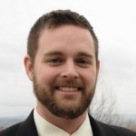
The Speakers: Up Close and Personal
Jay Clark
Jay is a member of the MMF Steering Team and focuses on Mobile and Digital Content Projects in the Tech Resources division at Mission Aviation Fellowship. MAF offers educational and technical expertise to ministries reaching isolated pastors and church leaders. Jay is the product manager for Estante, an Android digital library tool developed by MAF. Jay has a background in modern web development and technical writing and currently enjoys mobile web development. In his spare time, he enjoys spending time with his family and mountain biking or snow skiing.
Nancy Keel
Nancy is the wife of Stephen Keel, founder of Kiosk Evangelism. He pioneered mobile technology from 2008 to 2011 and was instrumental in founding the Mobile Ministry Forum (MMF). After his death in 2012, Nancy continued pioneering and promoting mobile ministry in India, Africa, and South America using offline distribution. Her website, BibleTransmission, has links to over 1,600 audio Bibles available for free download. She currently distributes Gospel media via mobile ads directly to developing nations.

Slide 16
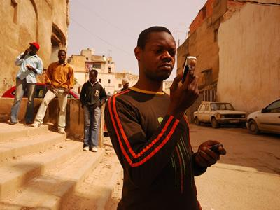
Tweets: Join the Conversation
Christian technologist missionaries need to live in the context they serve, using mobile tech in relationship with real people #mobmin2015
Jay Clark, @rlsix
The internet is discipling the church, not the other way round. #mobmin2015
Sam Peckham, @sampeckham
Mobile phones are now used for messaging communication over voice calls. - @tomiahonen #mobmin2015
Luke Shepherd, @lhshepherd19
The primary use of the mobile phone is text messaging. @tomiahonen #mobmin2015
Clyde Taber, @clydetaber
By all means 'Get content to people, don't worry about follow-up - you don't know will happen next' #mobmin2015
One Sheep, @onesheepmedia
“By 2019, all mobile phones will be smartphones." @tomiahonen #mobmin2015
Clyde Taber, @clydetaber
Is it true? Did you know - New Zealand 38% of people settle an argument finding an answer on a mobile phone! In the US it's 53%. #mobmin2015
One Sheep, @onesheepmedia
Avg smartphone user in U.K. looks at his/her phone 221 times per day. #mobmin #mobmin2015
Brian James, @KingdomGuy1
The average cell phone user looks at their phone 221 times a day. #fact #research #mobmin2015
Liam Savage, @liamsavage
This might help some of #mobmin #mobmin2015 see the context for mobile clearer: http://weblog.cenriqueortiz.com/mobile-context/ The Mobile Context by @eortiz
Mobile Ministry Mag, @mobileminmag
Photo: One Sheep Media, 2015.

Slide 17
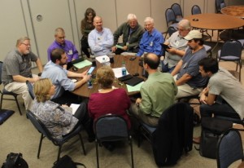
History of the Mobile Ministry Forum Consultation
The first Mobile Ministry Forum Consultation was held in Ringold, VA, in December, 2010 and drew 16 mission strategists representing 15 organizations. This gathering grew out of an increasing interest in the mobile device and its implications for Great Commission ministry. A second consultation took place in Waxhaw, NC, in December, 2011 involving 50 participants. The third consultation took place at Wycliffe Bible Translators in December 2012 with 119 participants from 57 organizations. The fourth consultation took place in Orlando at Wycliffe with 132 participants from 85 organizations. Here are the executive summaries from 2010, 2011, 2012 and 2013.

Slide 18
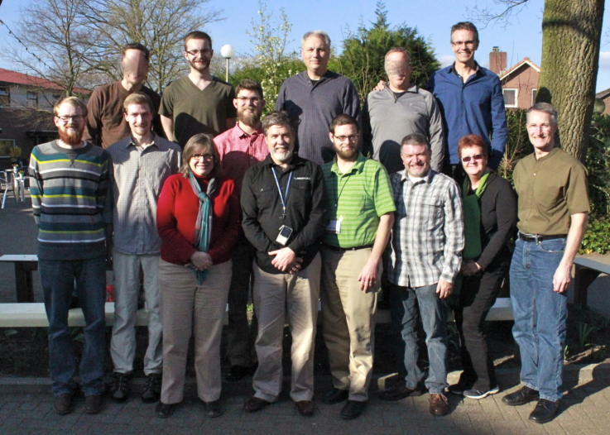
For More Information: Contact Us
Sign up for regular MMF communications here.
For more information, email info@mobileministryforum.org or contact members of the steering committee below.
Benjamin Tangeman, btangeman@twr.org
Brian James, greatcommworkers@gmail.com
Clyde Taber, clyde@visualstory.org
Darcie Drymon, darcie_drymon@tsco.org
Jay Clark, jclark@maf.org
Johnathan Pulos, johnathan@missionaldigerati.org
Keith Williams, keith@mobileadvance.org

