Slide 1
Mobile Ministry…

Slide 2
Why?

Slide 3
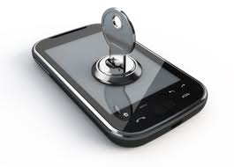
Why?

Slide 4
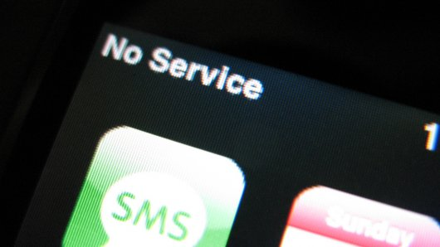
Why?

Slide 5
Devices
Estante
Use Cases
(Security) Questions

Slide 6
How?

Slide 7
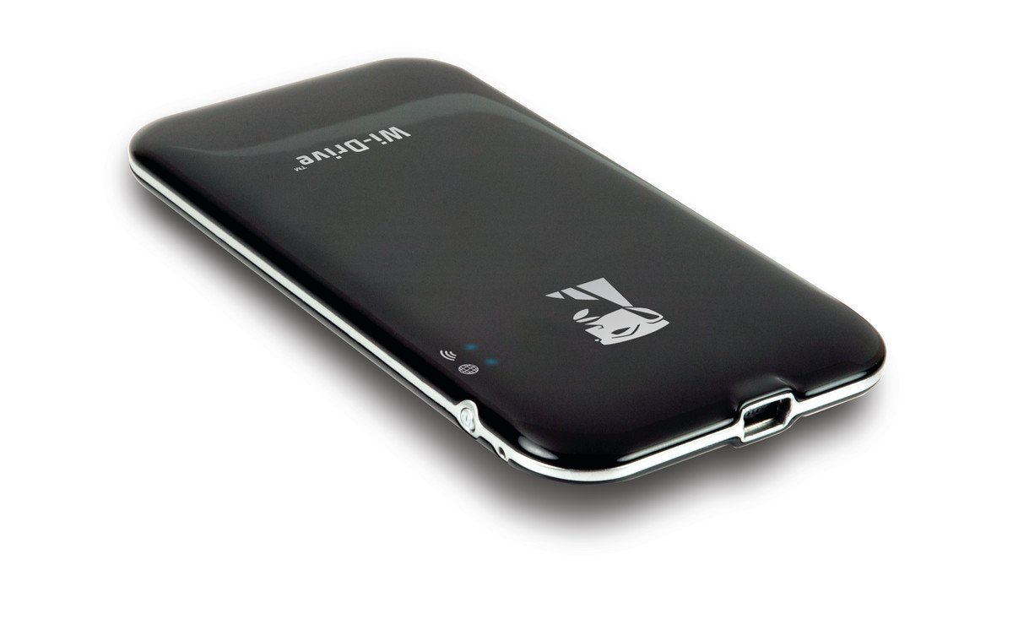
Kingston
Wi-Drive
Portable Wi-Fi Storage
Serves around 8 concurrent users and allows for Internet pass-through. Comes in 16GB, 32GB and 64 GB models.
32GB model available at Amazon.com for just $45.

Slide 8
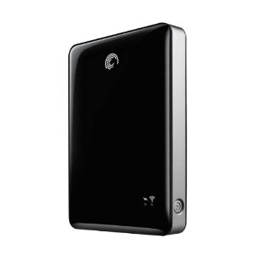
Seagate GoFlex Satellite
Mobile Wireless Storage
500GB drive serves up to 10 users concurrently and can stream HD video up 30 feet or more. Works with Android and iOS devices, laptops, and more.
Available at Amazon.com for $99.

Slide 9
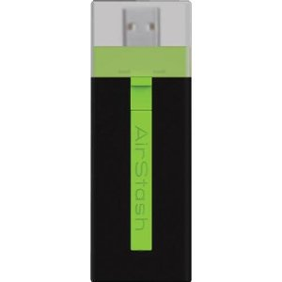
Maxell AirStash
Expandable Wireless Flash Drive
Uses SD cards for ease of use and affordable memory upgrades. Supports Internet pass-through. Can stream HD video and serve up to 9 concurrent users.
Available at Amazon.com for under $130.

Slide 10
Maxell AirStash
Expandable Wireless Flash Drive
Give it a Try!
Connect to the AirStash Wi-Fi signal, then
Install & open the AirStash app for Android or iOS or Navigate to http://airstash.net
Open the “MMF2012” folder.

Slide 11
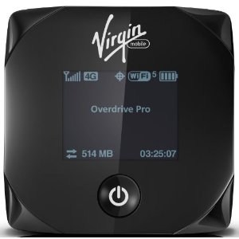
Overdrive Pro 3G/4G Mobile Hotspot
Use as a prepaid mobile hotspot for internet access, OR insert a microSD card and use as a micro server offering up to 5 concurrent connections (no cost).
Available at Amazon.com for under $60

Slide 12
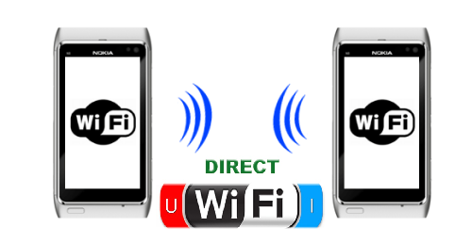
Wi-Fi Direct
Wi-Fi Direct is a new technology for setting up peer-to-peer wireless networks between multiple devices. It is easy to set up, secure, fast, and has a range of up 200 feet. It is ideal for quickly sharing large files such as videos.

Slide 13
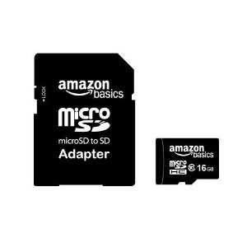
The Mighty Micro!
Most tablets and nearly every non-iPhone on the planet can utilize these tiny, high-capacity, low-cost, easy-to-distribute memory cards. A 2GB card with SD card adapter can be found for $5 or less.

Slide 14
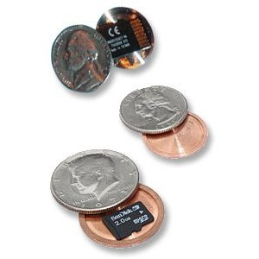
microSD cards are easy to conceal
A variety of hidden storage gadgets are available for concealing microSD cards. These range from coins to pens and much more.

Slide 15
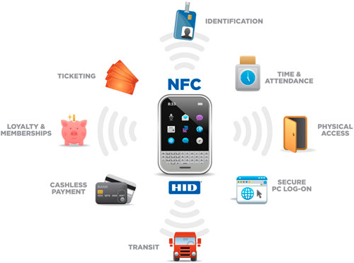
NFC
Near Field Communications
Touted as the next big thing in mobile technology, NFC is an enhanced version of RFID technology. With a narrow range of around 4”, it is designed for fast, secure data sharing.
Notes:
See http://video-sharing-hub.blogspot.com/2012/09/what-is-nfc-and-what-can-it-do-for-you.html for a good, brief overview of NFC technology.

Slide 16
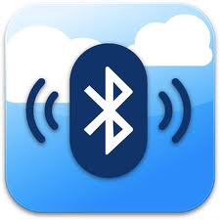
Bluetooth
File Transfer
Much of the world is far more Bluetooth savvy than those of us in America. Nearly 90% of phones being shipped today globally are Bluetooth-enabled. Every cross-cultural worker today should get familiar with how to use bluetooth to share media.

Slide 17
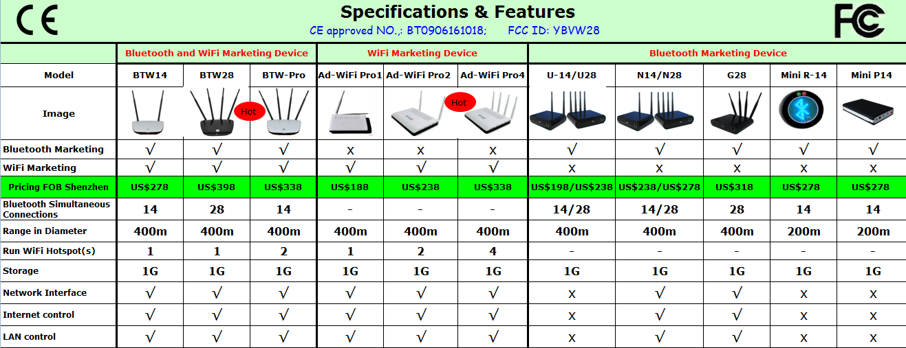
Bluetooth
Broadcasting

Slide 18
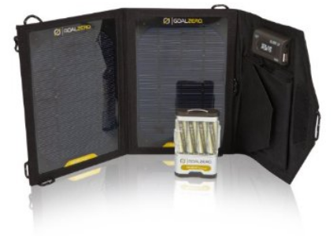
Goal Zero
Solar Charger for Mobile Devices
Rugged, ultra-lightweight solar panel and battery charger. Prices begin at around $75 (depending on the size and capacity of the solar charger).
Notes:
See http://video-sharing-hub.blogspot.com/2012/09/what-is-nfc-and-what-can-it-do-for-you.html for a good, brief overview of NFC technology.

Slide 20
MAF-LT
www.maflt.org/estante

Slide 21
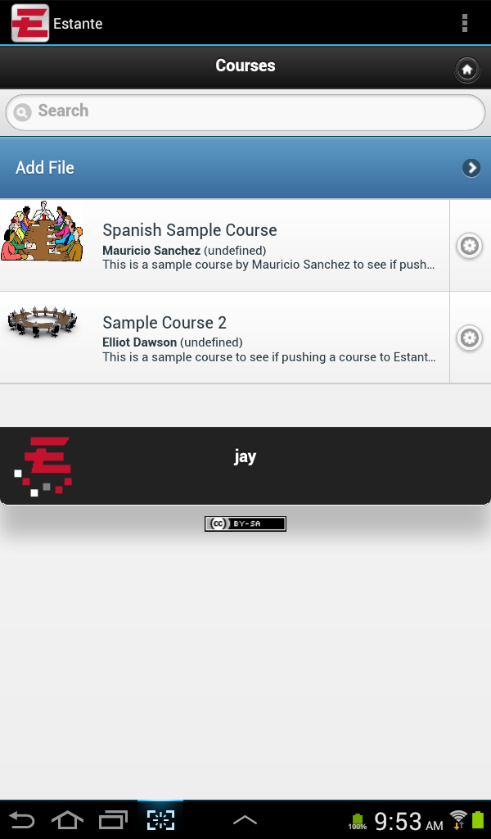
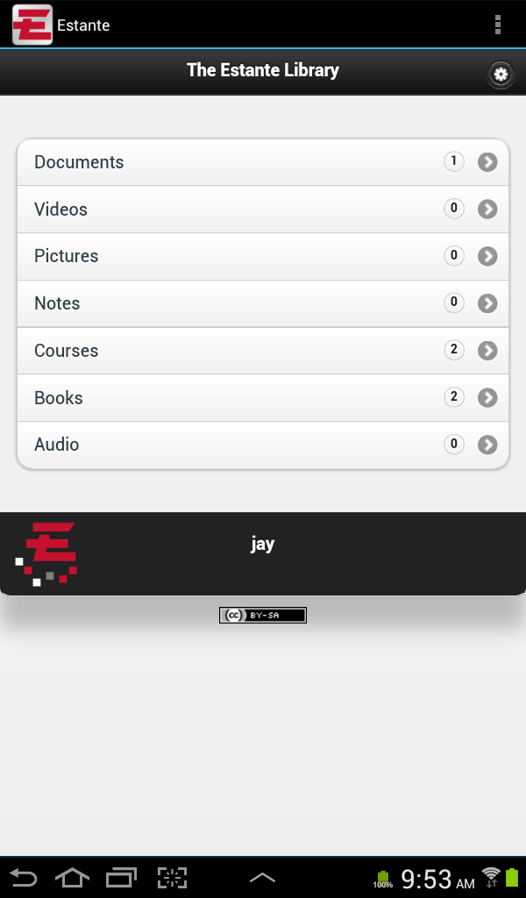

Slide 22
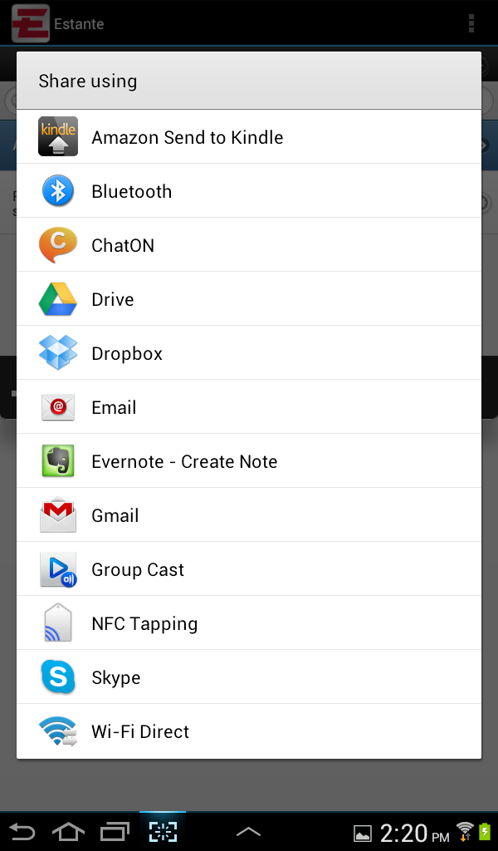
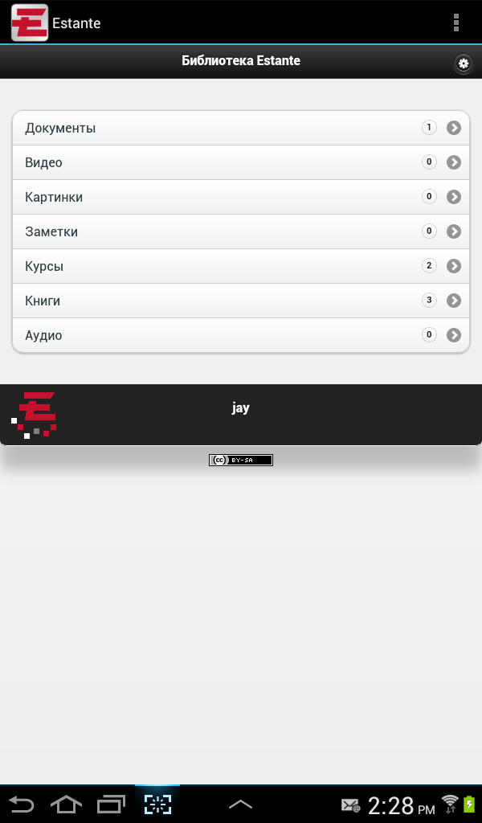

Slide 23
Examples

Slide 24
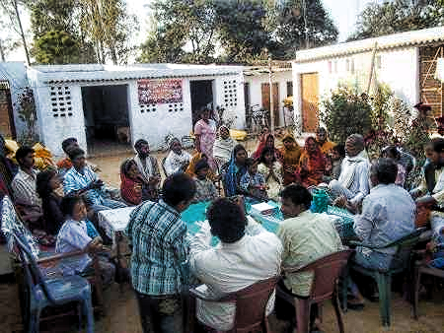
www.kioskevangelism.com
Notes:
Mobile Evangelism Training Workshop conducted in October 2011, in Bihar, IndiaFollowing a 10-day trip that included many jungle villages in Nepal, Moses Abraham reported...
according to my calculation 60 received Telugu audio bibles and 80 received materials in their cell phones and most of them received Jesus Film clips...
Source: www.kioskevangelism.org

Slide 25
www.DigitalBibleSociety.com
Notes:
Mobile Evangelism Training Workshop conducted in October 2011, in Bihar, IndiaFollowing a 10-day trip that included many jungle villages in Nepal, Moses Abraham reported...
according to my calculation 60 received Telugu audio bibles and 80 received materials in their cell phones and most of them received Jesus Film clips...
Source: www.kioskevangelism.org

Slide 26
Security Questions

